Slide 1
Java Message Service (JMS)
CS 595 Web Services
Aysu Betin-Can

Slide 2
What is JMS?
A specification that describes a common way for Java programs to create, send, receive and read distributed enterprise messages
loosely coupled communication
Asynchronous messaging
Reliable delivery
  A message is guaranteed to be delivered once and only once.
Outside the specification
  Security services
  Management services
Notes:
Asynchronous. A JMS provider can deliver messages to a client as they arrive; a client does not have to request messages in order to receive them.
Lower levels of reliability are available for applications that can afford to miss messages or to receive duplicate messages.
The JMS specification describes a set of programming interfaces that support distributed, enterprise messaging. An enterprise messaging systems enables independent distributed components or applications to interact through messages. These components, whether on the same system, the same network, or loosely connected through the Internet, use messaging to pass data and coordinate their respective functions.
exposing only the JMS APIs is to hide the details from the users that want a higher-level API and also to ensure portability among implementations.
As long as the vendor adheres to the JMS specification, a user shouldn't have to worry too much about how the implementation is constructed.
By itself, it provides no functionality: the API or interfaces are separate from the implementation This gives the benefit of describing in detail what the user view should be, while at the same time allowing vendors to implement the details however they want.
JMS is not an implementation of a message-oriented middleware.
security and management are not the concerns of the JMS spec

Slide 3
A JMS Application
JMS Clients
  Java programs that send/receive messages
Messages
Administered Objects
  preconfigured JMS objects created by an admin for the use of clients
  ConnectionFactory, Destination (queue or topic)
JMS Provider
  messaging system that implements JMS and administrative functionality
Notes:
A JMS Application is one or more JMS clients that exchange messages asynchronously

Slide 4
JMS Administration
Administrative
Tool
Bind
JNDI Namespace
Lookup
JMS Provider
JMS Client
Logical
Connection
Notes:
JNDI:java naming and directory service
administrative tool allows you to bind cf,dest to jndi. Clients lookup the admin objects in the jndi and then establish a logical connection to the same objects through provider
2 types of administrative objects: connection factory, destination
administrated objects are placed in a JNDI by admin.
a JMS client notes in its documentation the JMS admin objects it requires and how the JNDI names of these objects should be provided to it.
Connection factories are created by the server administrator and bound into the Java Naming and Directory Interface (JNDI) tree.
A JMS client uses JNDI to look up the ConnectionFactory and then uses the ConnectionFactory to establish a JMS connection.

Slide 5
JMS Messaging Domains
Point-to-Point (PTP)
  built around the concept of message queues
  each message has only one consumer
Publish-Subscribe systems
  uses a “topic” to send and receive messages
  each message has multiple consumers
Notes:
A JMS Application is one or more JMS clients that exchange messages asynchronously.
JMS deals with two kinds of message domains. -
Point-to-Point (PTP) are built around the concept of message queues.
Publish-Subscribe systems use a “topic” to send and receive messages.
Supports messages containing Java objects and XML pages.

Slide 6
Point-to-Point Messaging
Msg
Msg
consumes
Client1
Client2
Queue
sends
acknowledges
Notes:
1 consumer
a sender and a receiver have no timing dependencies. the receiver can fetch the mesg whether or not it was running when client sent the msg
receiver acknowledges

Slide 7
Publish/Subscribe Messaging
subscribes
Topic
Client2
Msg
Client1
delivers
publishes
subscribes
Client3
delivers
Notes:
multiple consumers
publishers and subscribers have timing dependency. a client can consume only msgs published after its subscription and must continue to be active to consume msgs
( exception durable subscription)

Slide 8
Message Consumptions
Synchronously
  A subscriber or a receiver explicitly fetches the message from the destination by calling the receive method.
  The receive method can block until a message arrives or can time out if a message does not arrive within a specified time limit.
Asynchronously
  A client can register a message listener with a consumer.
  Whenever a message arrives at the destination, the JMS provider delivers the message by calling the listener's onMessage() method.
Notes:
A message listener is similar to an event listener

Slide 9
JMS API Programming Model
Connection
Factory
creates
Connection
Message
Producer
Message
Consumer
creates
Session
creates
receives
from
sends to
creates
Destination
Msg
Destination
Notes:
JMS Interfaces:
connectionfactory: administrative object used by client to create a connection
connection: an active connection for JMS provider
destination: administrative object that encapsulates the identity of a message destination
session: a single-threaded context for sending/receiving message
messageproducer: an object created by a session that is used for sending msg to a dest
messageconsumer: similar

Slide 10
JMS Client Example
Setting up a connection and creating a session
InitialContext jndiContext=new InitialContext();
//look up for the connection factory
ConnectionFactory cf=jndiContext.lookup(connectionfactoryname);
//create a connection
Connection connection=cf.createConnection();
//create a session
Session session=connection.createSession(false,Session.AUTO_ACKNOWLEDGE);
//create a destination object
Destination dest1=(Queue) jndiContext.lookup(“/jms/myQueue”); //for PointToPoint
Destination dest2=(Topic)jndiContext.lookup(“/jms/myTopic”); //for publish-subscribe
Notes:
transacted session
connection.createSession(true,0);
AUTO_ACK: when client succesfully returned froma call to receive or when messagelistener returned successfully
Client_ACK: a client acks a mesg by calling the message’s acknowledge() method ( consume 10 ack 5th, you acked for all 10)
DUPS_ACK:dups are permitted, lazy ack (??)

Slide 11
Producer Sample
Setup connection and create a session
Creating producer
MessageProducer producer=session.createProducer(dest1);
Send a message
Message m=session.createTextMessage();
m.setText(“just another message”);
producer.send(m);
Closing the connection
connection.close();
Notes:
transacted session
connection.createSession(true,0);
AUTO_ACK: when client succesfully returned froma call to receive or when messagelistener returned successfully
Client_ACK: a client acks a mesg by calling the message’s acknowledge() method ( consume 10 ack 5th, you acked for all 10)
DUPS_ACK:dups are permitted, lazy ack (??)

Slide 12
Consumer Sample (Synchronous)
Setup connection and create a session
Creating consumer
MessageConsumer consumer=session.createConsumer(dest1);
Start receiving messages
connection.start();
Message m=consumer.receive();

Slide 13
Consumer Sample (Asynchronous)
Setup the connection, create a session
Create consumer
Registering the listener
  MessageListener listener=new myListener();
  consumer.setMessageListener(listener);
myListener should have onMessage()
  public void onMessage(Message msg){
  //read the massage and do computation
  }
Notes:
register the listener

Slide 14
Listener Example
public void onMessage(Message message) {
TextMessage msg = null;
try {
if (message instanceof TextMessage) {
msg = (TextMessage) message;
System.out.println("Reading message: " + msg.getText());
} else {
System.out.println("Message of wrong type: " +
message.getClass().getName());
}
} catch (JMSException e) {
System.out.println("JMSException in onMessage(): " + e.toString());
} catch (Throwable t) {
System.out.println("Exception in onMessage():" + t.getMessage());
}
}

Slide 15
JMS Messages
Message Header
  used for identifying and routing messages
  contains vendor-specified values, but could also contain application-specific data
  typically name/value pairs
Message Properties (optional)
Message Body(optional)
  contains the data
  five different message body types in the JMS specification

Slide 16
JMS Message Types
Message Type | Contains | Some Methods
TextMessage | String | getText,setText
MapMessage | set of name/value pairs | setString,setDouble,setLong,getDouble,getString
BytesMessage | stream of uninterpreted bytes | writeBytes,readBytes
StreamMessage | stream of primitive values | writeString,writeDouble,writeLong,readString
ObjectMessage | serialize object | setObject,getObject
Notes:
TextMessage m=session.createTextMessage();

Slide 17
More JMS Features
Durable subscription
  by default a subscriber gets only messages published on a topic while a subscriber is alive
  durable subscription retains messages until a they are received by a subscriber or expire
Request/Reply
  by creating temporary queues and topics
    Session.createTemporaryQueue()
  producer=session.createProducer(msg.getJMSReplyTo());
  reply= session.createTextMessage(“reply”);
  reply.setJMSCorrelationID(msg.getJMSMessageID);
  producer.send(reply);
Notes:
producer=session.createProducer(msg.getJMSReplyTo());
reply= session.createTextMessage(“reply”);
reply.setJMSCorrelationID(msg.getJMSMessageID);
producer.send(reply);

Slide 18
More JMS Features
Transacted sessions
  session=connection.createSession(true,0)
  combination of queue and topic operation in one transaction is allowed
  void onMessage(Message m) {
  try { Message m2=processOrder(m);
  publisher.publish(m2); session.commit();
  } catch(Exception e) { session.rollback(); }

Slide 19
More JMS Features
Persistent/nonpersistent delivery
  producer.setDeliveryMethod(DeliveryMode.NON_PERSISTENT);
  producer.send(mesg, DeliveryMode.NON_PERSISTENT ,3,1000);
Message selectors
  SQL-like syntax for accessing header:
  subscriber = session.createSubscriber(topic, “priority > 6 AND type = ‘alert’ ”);
  Point to point: selector determines single recipient
  Pub-sub: acts as filter
Notes:
send(msg,persistent, 3,100)
3: priority( default 4)
100: timeout (0 : no timeout)

Slide 20
JMS API in a J2EE Application
Since the J2EE1.3 , the JMS API has been an integral part of the platform
J2EE components can use the JMS API to send messages that can be consumed asynchronously by a specialized Enterprise Java Bean
  message-driven bean
Notes:
Since the 1.3 release of the J2EE platform ("the J2EE 1.3 platform"), the JMS API has been an integral part of the platform, and application developers can use messaging with components using J2EE APIs ("J2EE components").
J2EE Application server provides EJB, freeing applications from details of threading, transactions, scalability, fault-tolerance
J2EE components (Web components or Enterprise JavaBeans (EJB) components) can use the JMS API to send messages that can be consumed asynchronously by a specialized EJB, called a message-driven bean (MDB).
EJB is a server-side component that encapsulates the business logic of an application

Slide 21
Enterprise Java Beans
EJB is a server-side component that encapsulates the business logic of an application
EJB simplifies the development of large, distributed applications
  EJB Container provides system-level services
    e.g. transaction management, authorization
  Beans have the control logic
    thin client applications
  Portable components
    can run on any compliant J2EE server
Notes:
J2EE Application server provides EJB, freeing applications from details of threading, transactions, scalability, fault-tolerance
J2EE components (Web components or Enterprise JavaBeans (EJB) components) can use the JMS API to send messages that can be consumed asynchronously by a specialized EJB, called a message-driven bean (MDB).

Slide 22
Message–Driven Bean
acts as a listener for the JMS, processing messages asynchronously
specialized adaptation of the JMS API used in the context of J2EE applications
Notes:
EJB is a server-side component that encapsulates the business logic of an application

Slide 23
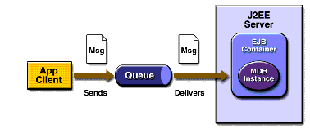
JMS with EJB Example
Notes:
EJB Container automatically performs several setup tasks that a standalone client has to do:
-creating a msgconsumer
instead, you associate the message-driven bean with a destination and connection factory at deployment time
durable subscription, message selector : do at deployment
-registering message listener
-specifying message acknowledgment mode

Slide 24
MDB Example
public class MB implements MessageDrivenBean, MessageListener{
public void ejbCreate(){}
public void ejbRemove(){}
public void setMessageDrivenContext(MessageDrivenContext mdc){}
pubic void onMessage(Message m){
//do computation on the incoming message
try{ if (m instanceof TextMessage)
System.out.println(“MBean: message”+m.getText());
}catch(JMSException exp){ ...}
}
}
Notes:
to create a new instance container calls
-setmessagedrivencontext to pass the context object
-then ejbcreate
EJB Container automatically performs several setup tasks that a standalone client has to do:
-creating a msgconsumer
instead, you associate the message-driven bean with a destination and connection factory at deployment time
durable subscription, message selector : do at deployment
-registering message listener
-specifying message acknowledgment mode

Slide 25
JMS and JNDI
JMS does not define a standard address syntax by which clients communicate with each other
Instead JMS utilizes Java Naming & Directory Interface(JNDI).
Using JNDI provides the following advantages:
  It hides provider-specific details from JMS clients.
  It abstracts JMS administrative information into Java objects that are easily organized and administrated from a common management console.
  Since there will be JNDI providers for all popular naming services, this means JMS providers can deliver one implementation of administered objects that will run everywhere. Thereby eliminating deployment and configuration issues.
Notes:
Although a standard address syntax was considered, it was decided that the differences in address semantics between existing MOM products was too wide to bridge with a single syntax.

Slide 26
SOAP and JMS
Use JMS as a transportation layer for SOAP
Example: Sun™ ONE Message Queue
  enables to send JMS messages that contain a SOAP payload
  allowing transportation of SOAP messages reliably and publishing SOAP messages to JMS subscribers
  http://docs.sun.com/source/817-0355-10/SOAP.html

Slide 27
SOAP and JMS
(using Sun™ ONE MQ)
Send a SOAP message
  Create a JMS session
  Create a SOAP message
  Transfer the SOAP message into JMS message
    Message myMsg= MessageTransformer.SOAPMessageIntoJMSMessage
    (SOAPMessage, Session);
  Send the JMS message

Slide 28
SOAP and JMS
(using Sun™ ONE MQ)
Receive a SOAP message
  Create a JMS session
  Receive the JMS message
  Transfer the JMS message into SOAP message
    SOAPMessage myMsg= MessageTransformer.SOAPMessageFromJMSMessage
    (Message, MessageFactory);

Slide 29
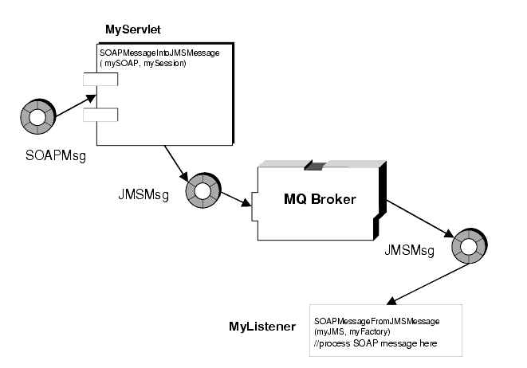
SOAP and JMS
(using Sun™ ONE MQ)
Deferring SOAP Processing
Notes:
In the first example, illustrated in Figure 5-9, an incoming SOAP message is received by a servlet. After receiving the SOAP message, the servlet MyServlet uses the MessageTransformer utility to transform the message into a JMS message, and (reliably) forwards it to an application that receives it, turns it back into a SOAP message, and processes the contents of the SOAP message
http://docs.sun.com/source/817-0355-10/SOAP.html

Slide 30
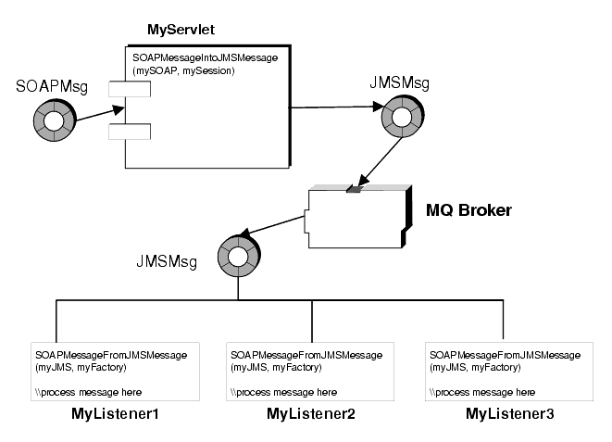
Publishing a SOAP message

Slide 31
JMS Providers
SunONE Message Queue (SUN)
  a JMS provider integrated with the SunONE Application Server
  http://www.sun.com
MQ JMS (IBM)
  MQSeries is another messaging technology
  can configure MQ as a JMS provider
  (http://www7b.software.ibm.com/wsdd/library/techtip/0112_cox.html)

Slide 32
JMS Providers
WebLogic JMS (BEA)
  enterprise-class messaging system integrated into WebLogic Server
  http://dev2dev.bea.com/technologies/jms/index.jsp
JMSCourier (Codemesh)
  merging C++ applications into a JMS environment
  http://www.codemesh.com/en/AlignTechnologyCaseStudy.html

Slide 33
More JMS Vendors
Fiorano Software http://www.fiorano.com
JRUN Server http://www.allaire.com
GemStone http://www.gemstone.com
Nirvana http://www.pcbsys.com
Oracle http://www.oracle.com
A more exhaustive listing is available at
  http://java.sun.com/products/jms/vendors.html
Notes:
Sun (Java Message Queue) http://www.sun.com
IBM http://www-4.ibm.com
JRUN Server http://www.allaire.com
BEA Systems, Inc. http://www.beasys.com
Fiorano Software http://www.fiorano.com
GemStone http://www.gemstone.com
Nirvana http://www.pcbsys.com
Oracle http://www.oracle.com
Orion http://www.orionserver.com
Progress Software http://www.progress.com
SAGA Software, Inc. http://www.sagasoftware.com
SoftWired Inc. http://www.softwired-inc.com
SpiritSoft, Inc. http://www.spirit-soft.com
Sunopsis http://www.sunopsis.com
SwiftMQ http://www.swiftmq.com
Venue Software http://www.venuesoftware.com

